Slide 1








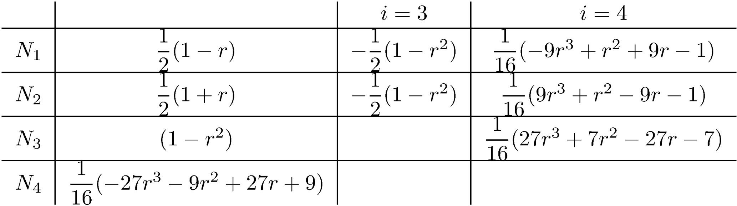
Shape functions for truss elements

Slide 2
Shape functions for rectangular elements
1
5
2
8
9
6
4
3
7

Slide 3
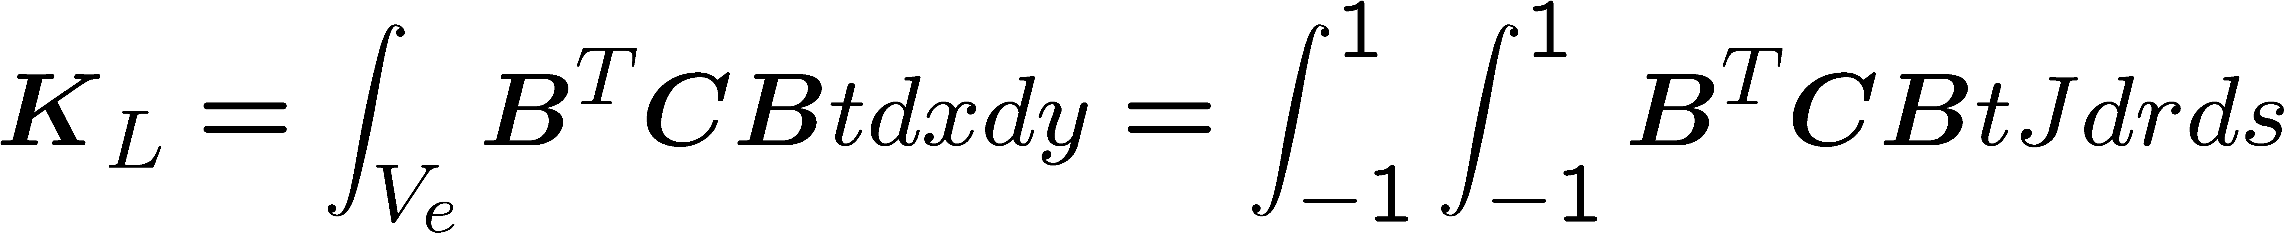
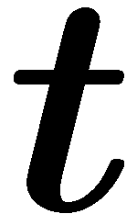
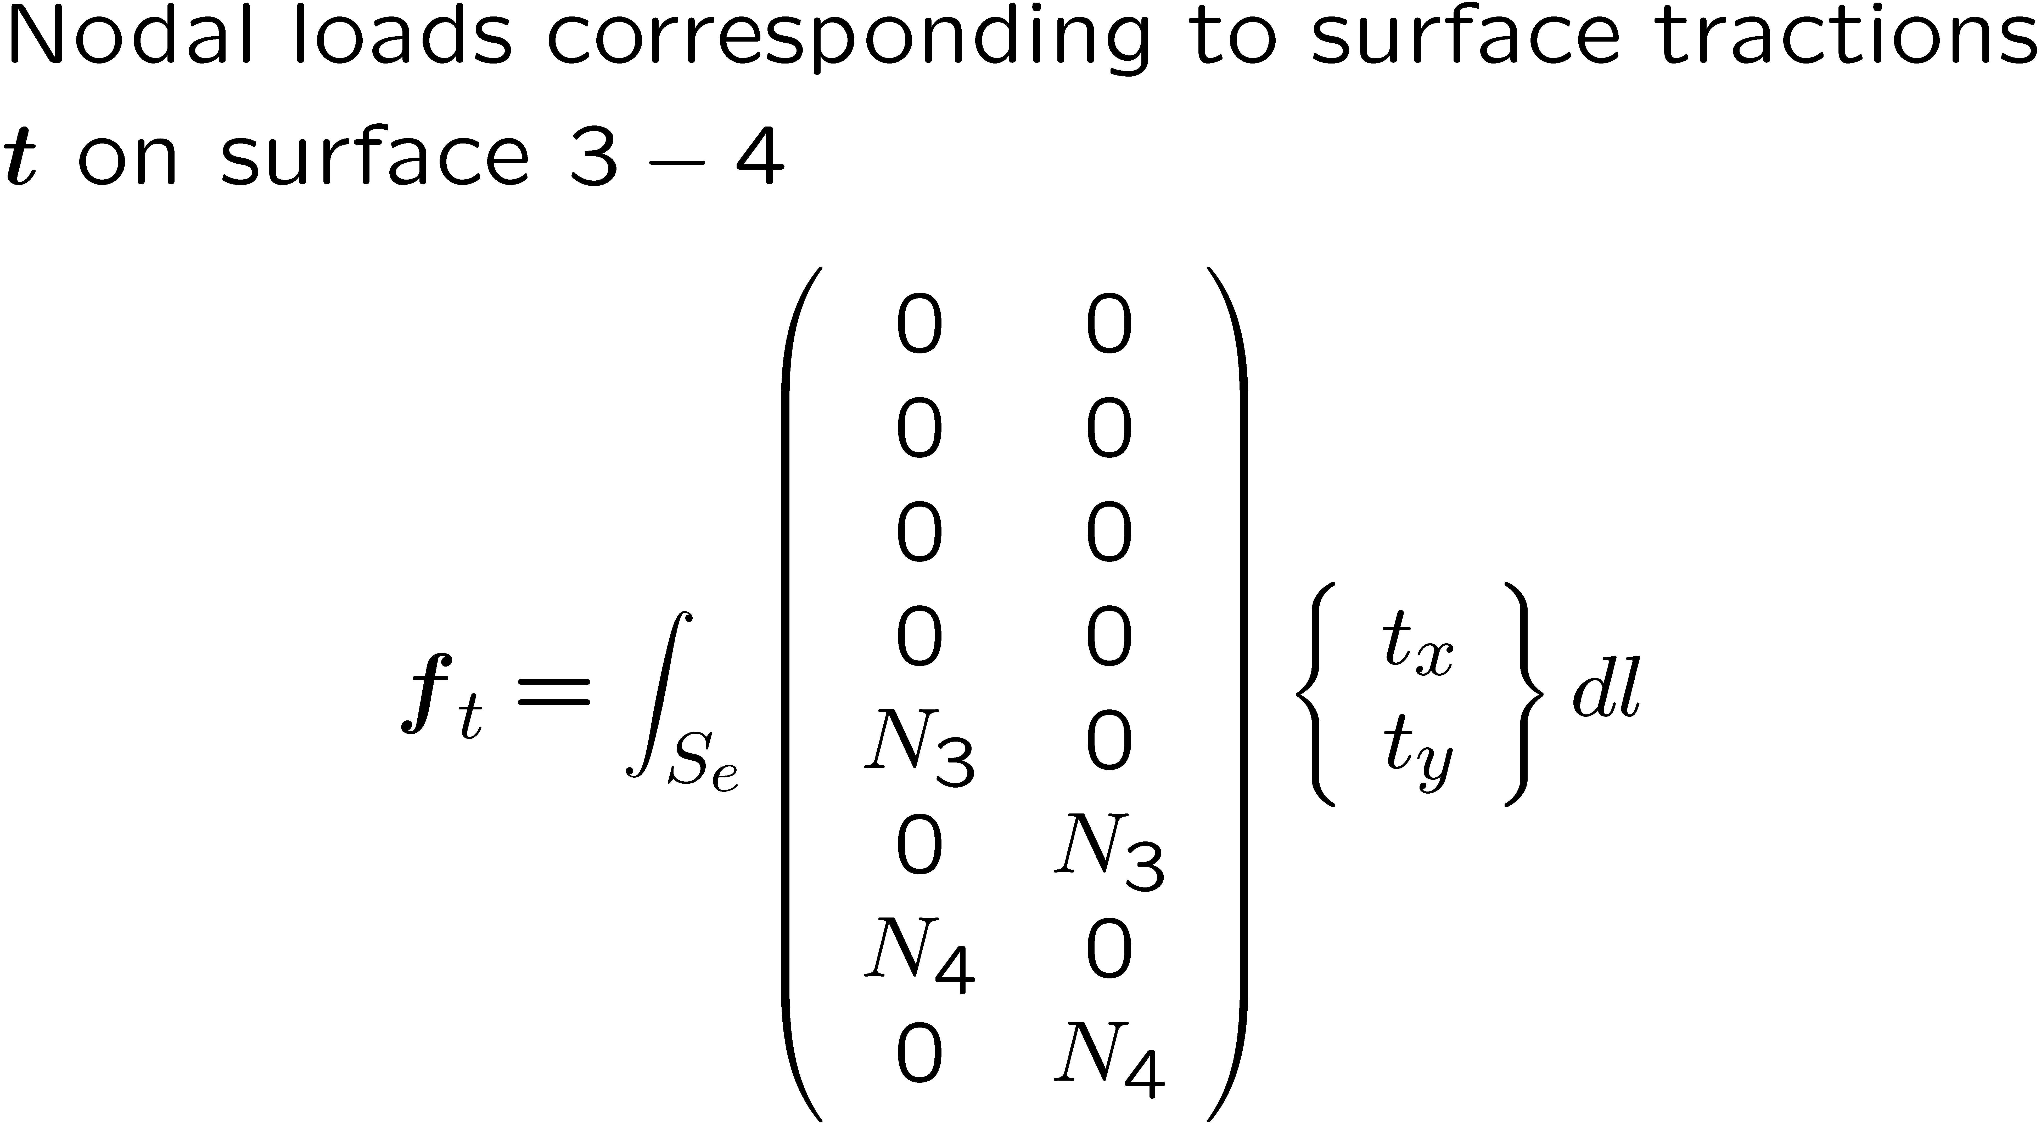
Stiffness matrix needs to be integrated numerically.

Slide 4
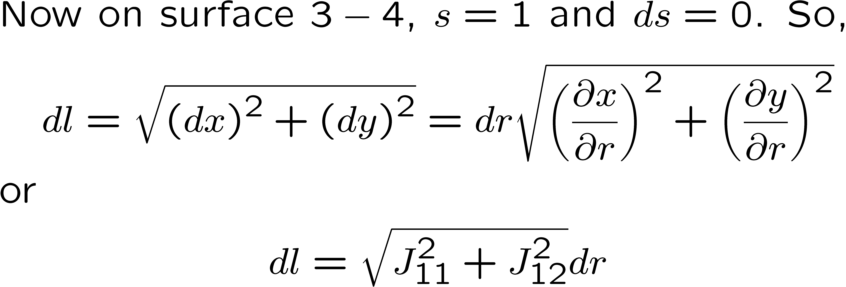

Slide 5










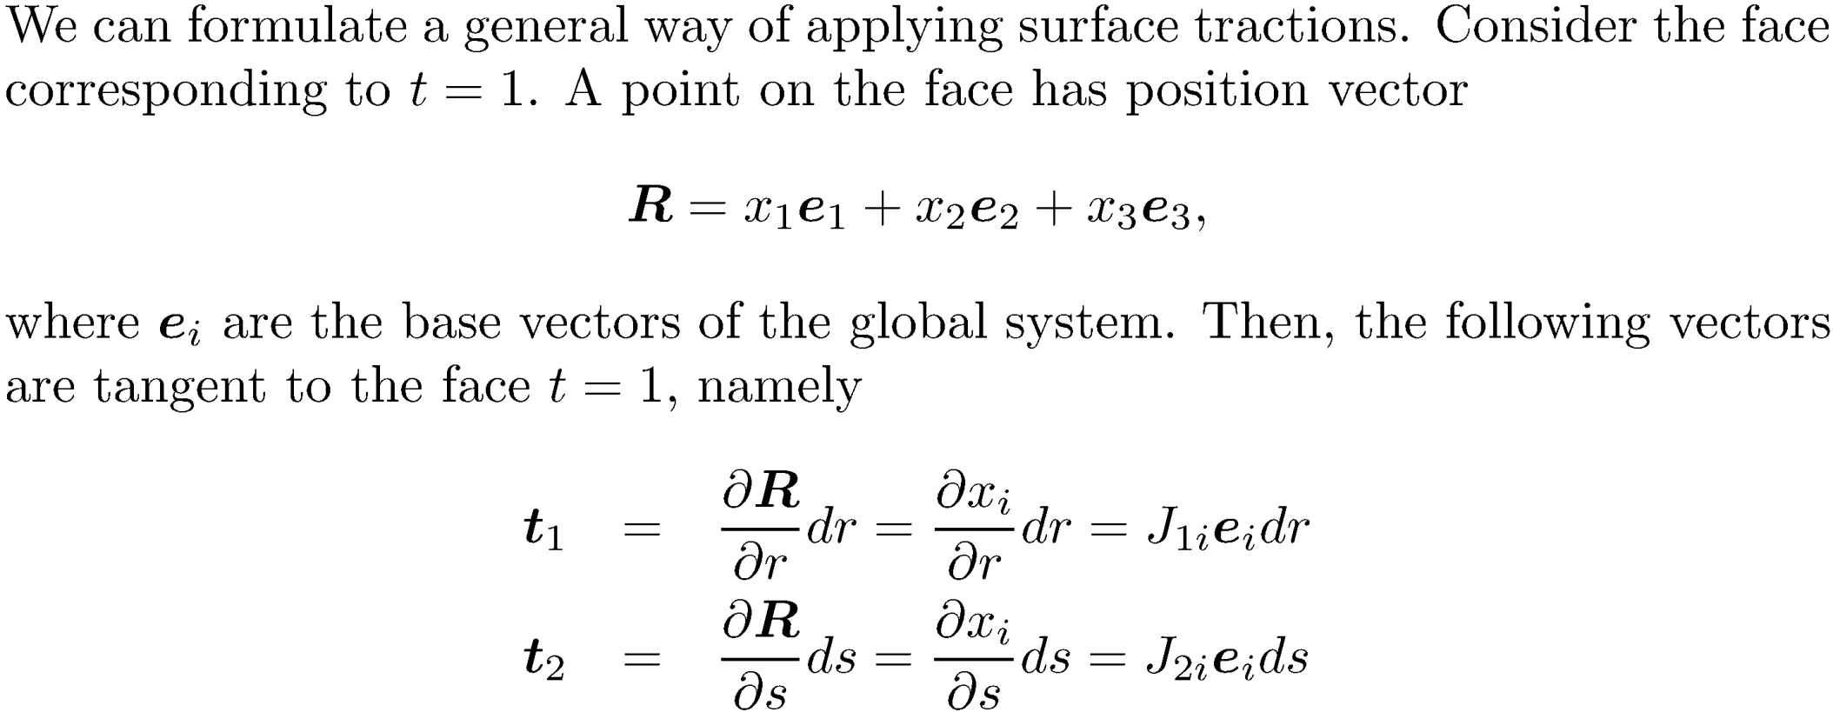

Slide 6
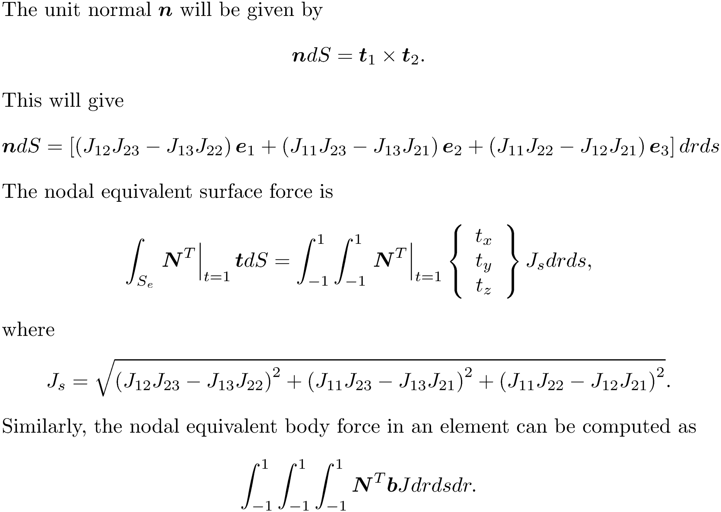

Slide 7
Numerical integration: Gauss quadrature-1d
r=-1
r=1
r=-1
r=1
Sampling points between -1 and 1
Weights

Slide 8
The idea behind a quadrature scheme….

Slide 10
Gauss quadrature: sample points and weights
n | Sampling points | weights
1 | 0 | 2
2 | 0.57735, -0.57735 | 1 1
3 | 0.77459, -0.77459 0 | 0.5555 0.5555 0.8888
4 | 0.86114 -0.86114 0.33998 -0.33998 | 0.34785 0.34785 0.65214 0.65214

Slide 11
Important rule: n point Gauss quadrature integrates a polynomial of order 2n-1 exactly

Slide 12
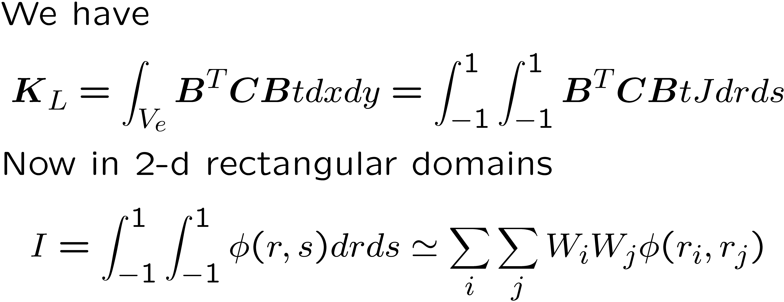




GI in 2-d
For the Q4 element, 2X2 quadrature is required
1
r s
r² rs s²
r³ r²s rs² s³
2X2

Slide 13


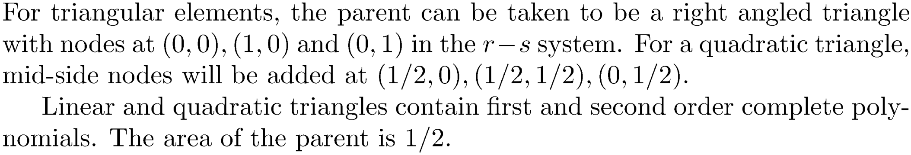
Triangular elements

Slide 14
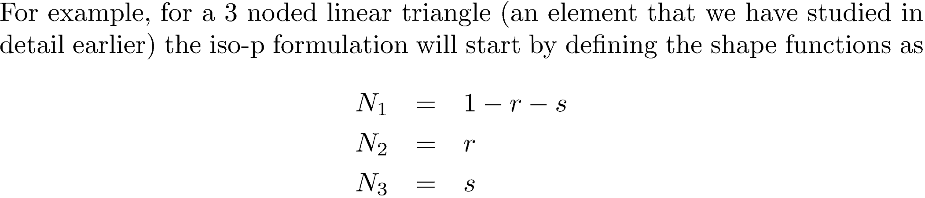
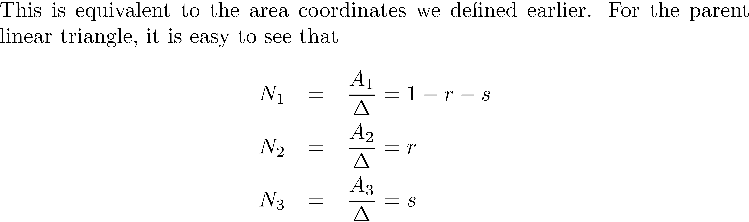




Slide 15
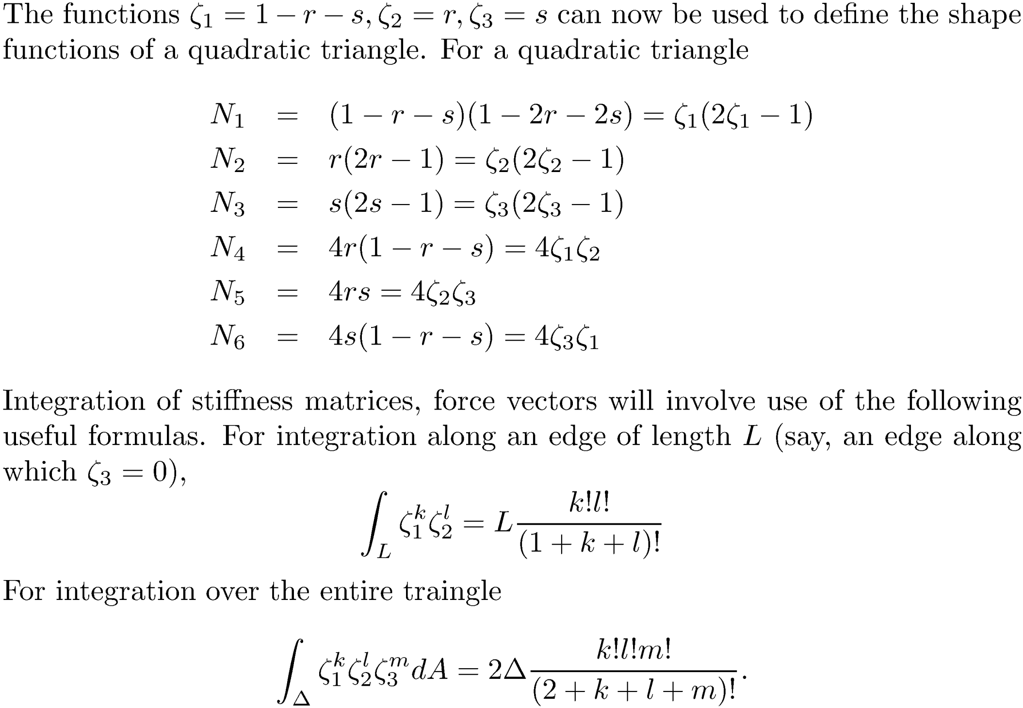

Slide 16
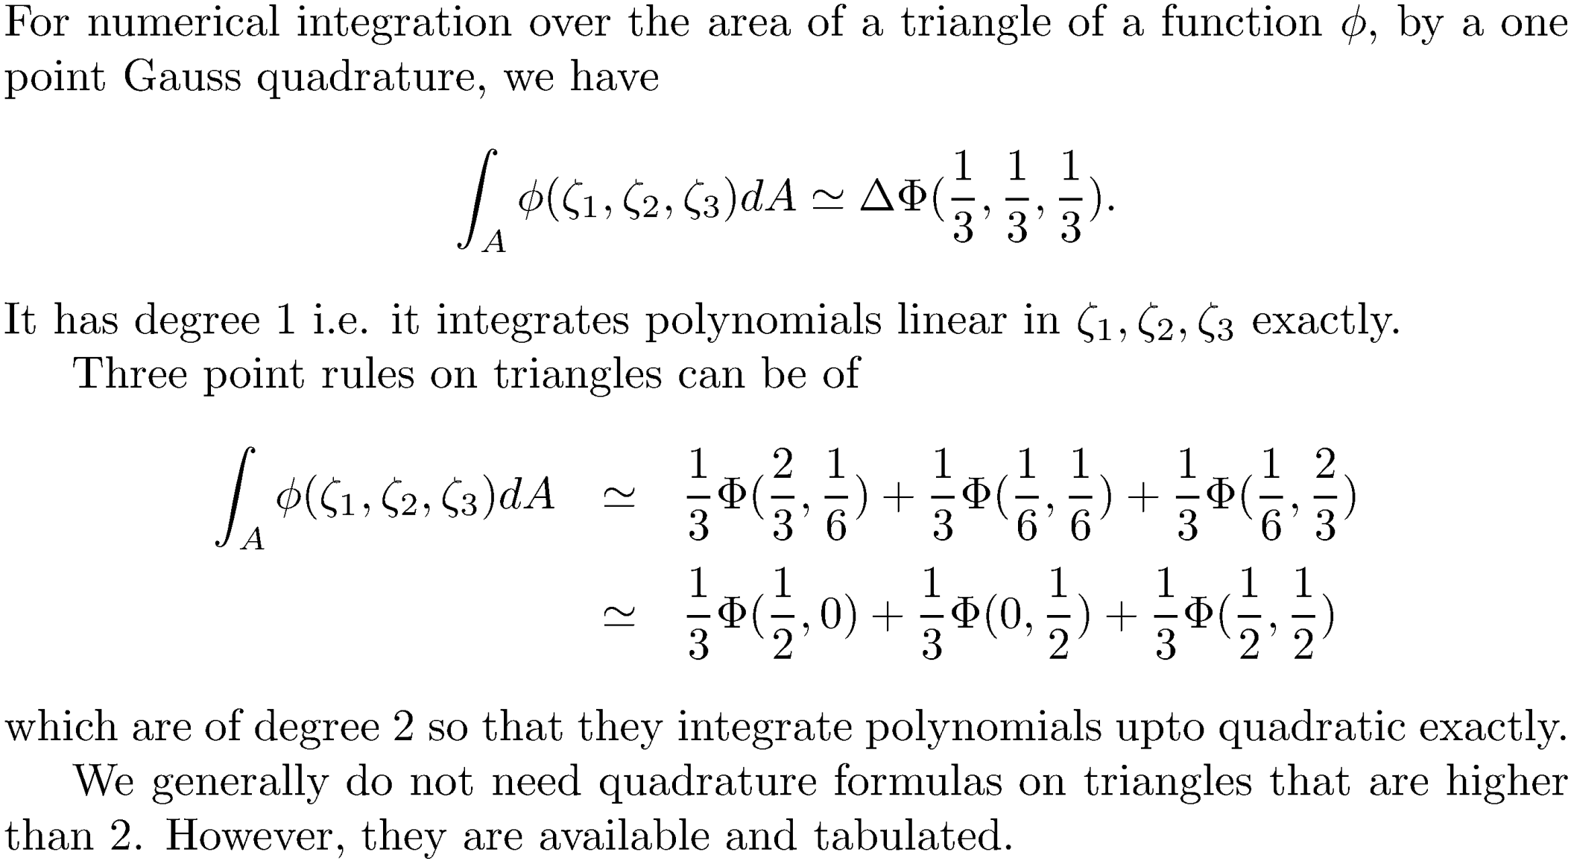

Slide 17






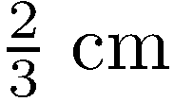




Problem

Slide 18
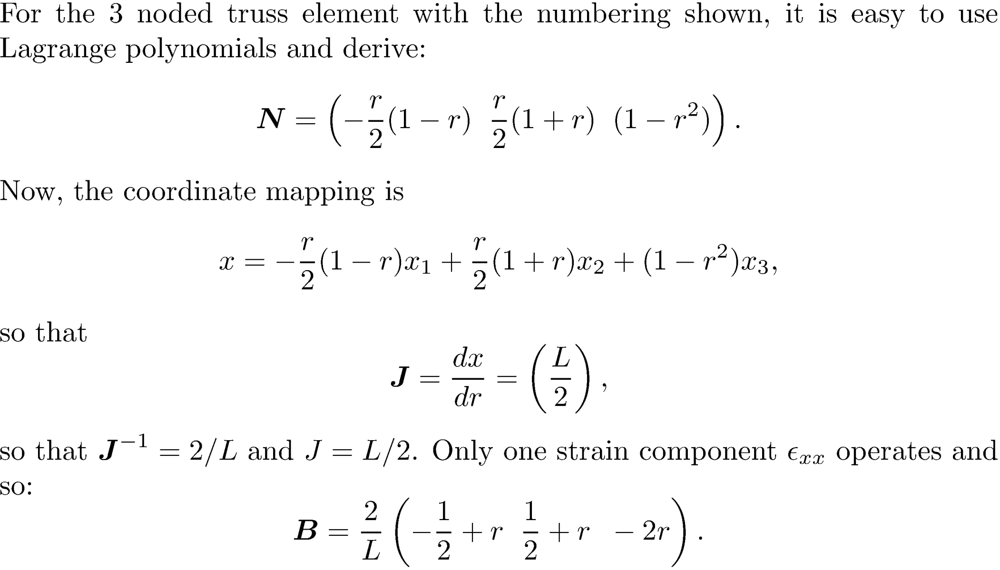

Slide 19
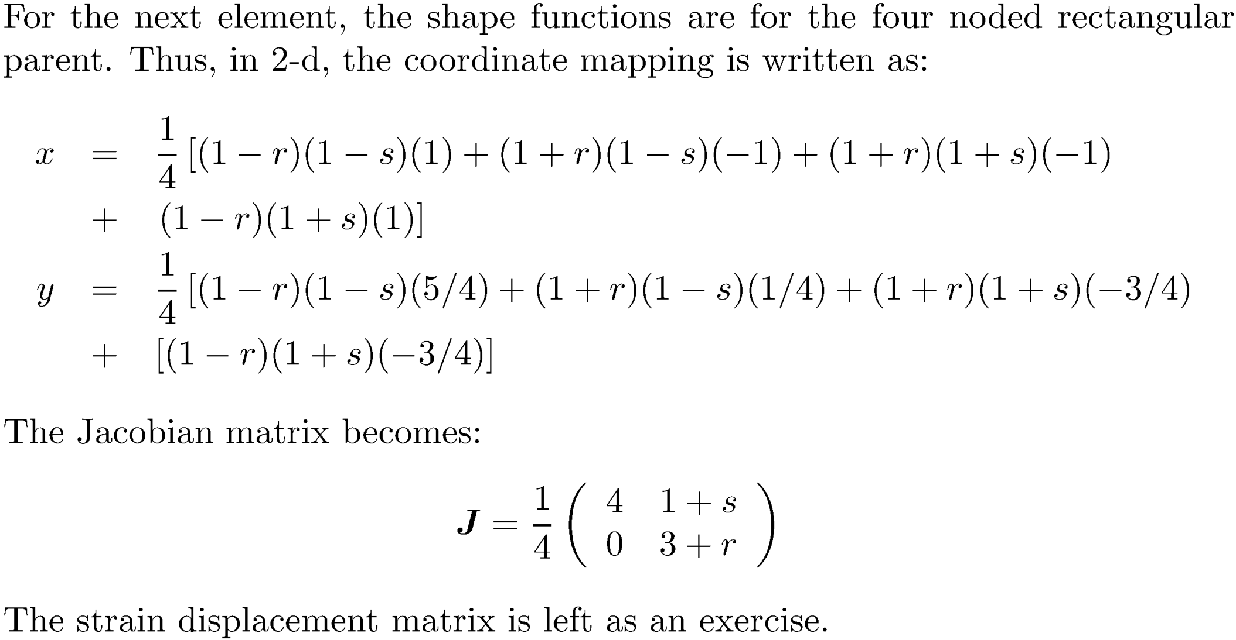

Slide 20
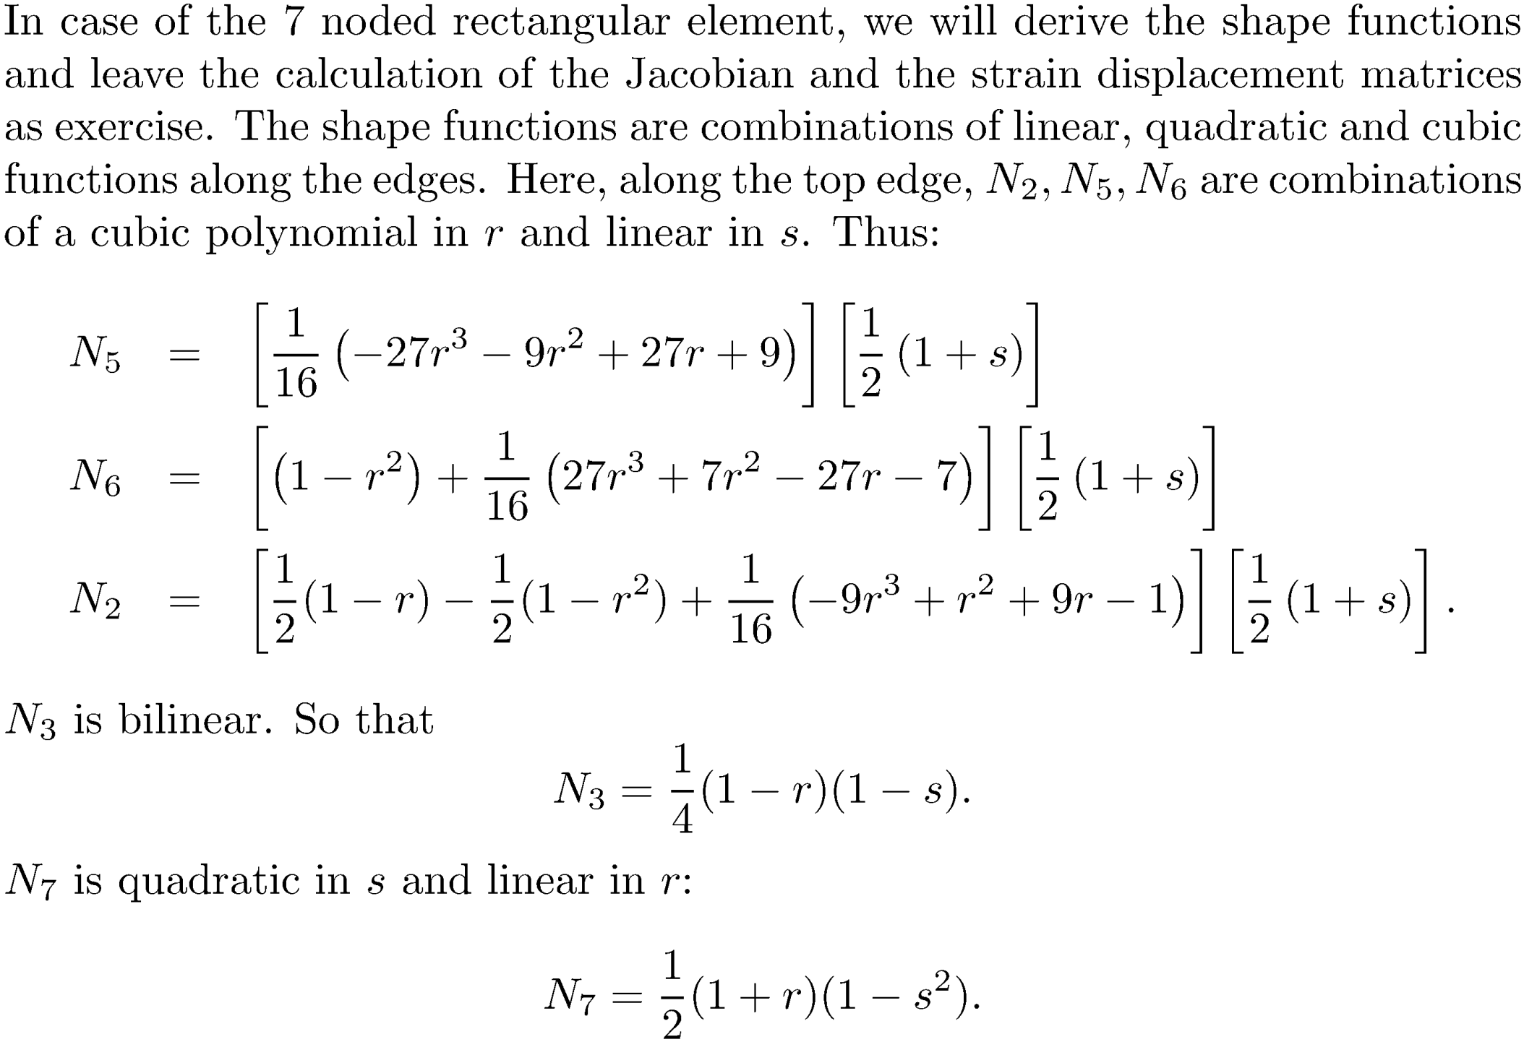

Slide 21
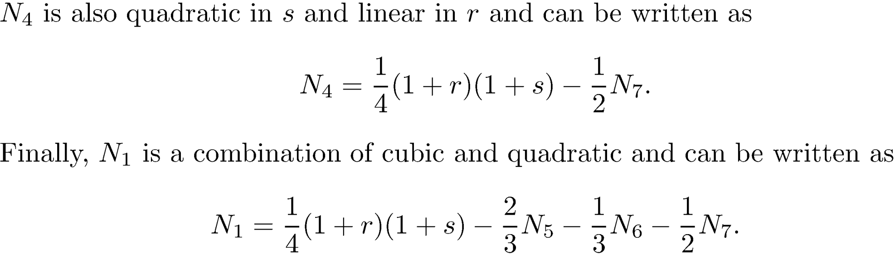

Slide 22
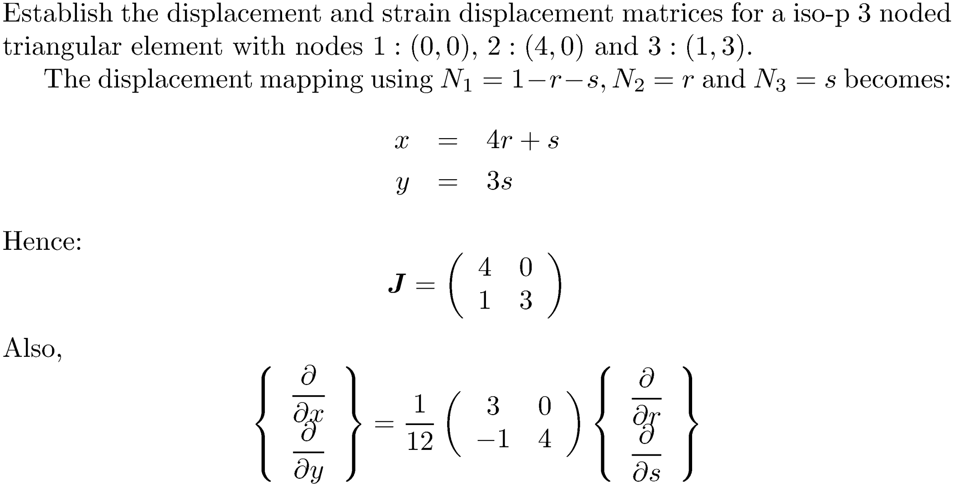
Problem

Slide 23
